Slide 1
STUDY OF INDIAN RESTAURANTS IN TORONTO, CANADA

Slide 2
STUDY OF INDIAN RESTAURANTS IN TORONTO, CANADA
Toronto is a place in Canada with a good number of Indian immigrants
This helps to identify the place where Indian restaurants having highest rating
Find the borough with more number of Indian restaurants
Find the best place to start a new Indian restaurant.

Slide 3
Data acquisition and cleaning
https://en.wikipedia.org/wiki/List_of_postal_codes_of_Canada:_M for getting the neighborhoods of Canada
http://cocl.us/Geospatial_data for getting latitude and longitude of each borough in Canada
Foursquare API for getting venue details
Only analysed the valid borough with name Toronto

Slide 4
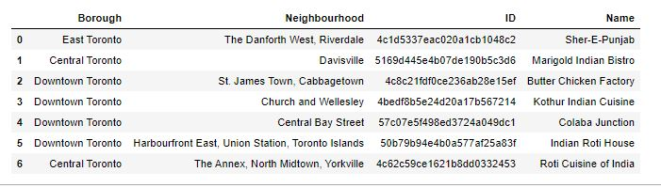
METHODOLOGY
Find the total number of Indian restaurants in Toronto.
There are 7 restaurants

Slide 5
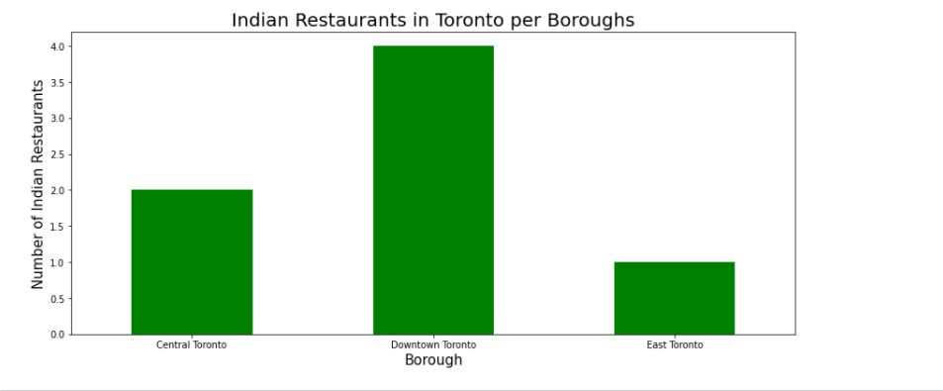
Identify the Borough with most number of Indian restaurant

Slide 6

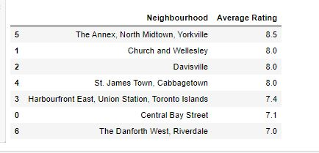
Identify the borough and neighbourhood with highest average rating

Slide 7
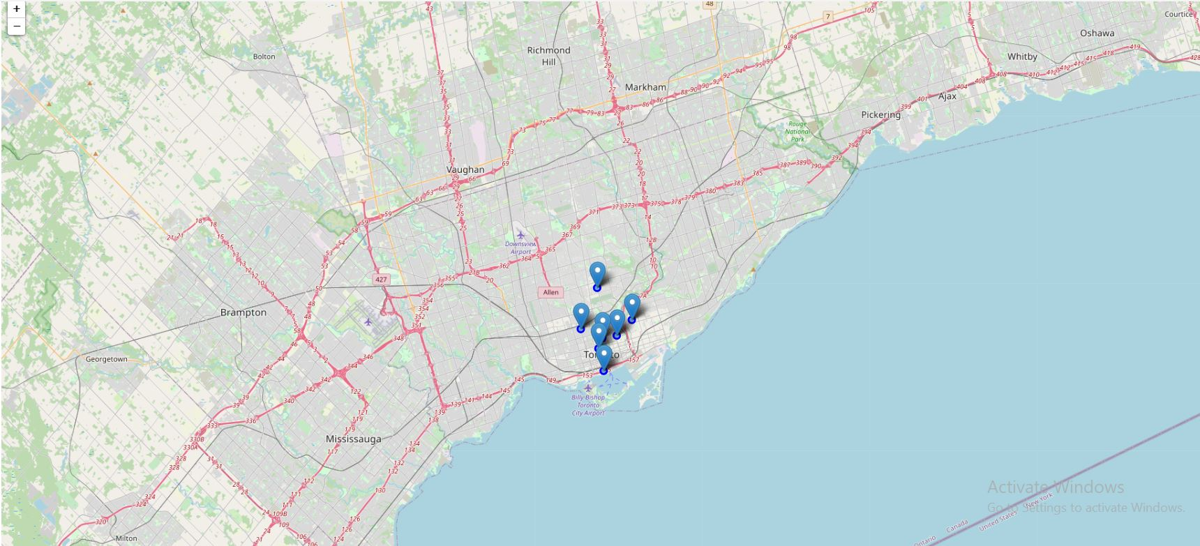
the map showing indian restaurants in toronto

Slide 8
RESULT
Tornoto has 7 Indian restaurants
Downtown Toronto is the borough with most number of Indian restaurants
Central Toronto is the borough with an Indian restaurant having highest average rating.
East Toronto is the borough with lowest number of Indian restaurants. So it is the best place to start a new Indian restaurant

Slide 9
CONCLUSION
Built useful models to predict which is the best place to start a Indian restaurant in Toronto
Accuracy of the models has room for improvement

